Slide 1
DATABASE MANAGEMENT SYSTEMS
Subject Teacher: Junaid Javed Korai

Slide 2
NORMALIZATION
Lecture #7 & 8
Disclaimer: The material used in this presentation to deliver the lecture i.e., definitions/text and pictures/graphs etc. does not solely belong to the author/presenter. The presenter has gathered this lecture material from various sources on web/textbooks. Following sources are especially acknowledged:
Connolly, Thomas M., and Carolyn E. Begg. Database systems: a practical approach to design, implementation, and management. Pearson Education, 2005.
2. Hoffer, Jeffrey A.,Venkataraman Ramesh, and Heikki Topi. Modern database management. Upper Saddle River, NJ: Prentice Hall,, 2011.
2

Slide 3
IN THIS LECTURE YOU WILL LEARN ABOUT:
What is Normalization
Why to Normalize Table?
Forms of Normalization

Slide 4








DATA NORMALIZATION
A tool to validate and improve a logical design so that it satisfies certain constraints that avoid unnecessary duplication of data
The process of decomposing relations with anomalies to produce smaller,
well-structured relations
4

Slide 5
NORMALIZATION
Normalization is the process of organizing data into a set of related tables; it also minimizes redundancy and increases the integrity which improves performance of the query.
Data normalization is a process in which data attributes within a data model are organized to increase the organization of entity types.
To normalize a database, we divide the database into tables and establish relationships between the tables.
The purpose of normalization is to identify a suitable set of relations that support the data
requirements of an enterprise.
5
6/10/2020

Slide 6
NORMALIZATION (CONT’D)
The characteristics of a suitable set of relations include the following:
  The minimal number of attributes necessary to support the data requirements of the enterprise;
  Attributes with a close logical relationship (described as functional dependency) are found in the same relation;
  Minimal redundancy with each attribute represented only once with the important exception of attributes that form all or part of foreign keys, which are essential for the joining of related relations.
The benefits of using a database that has a suitable set of relations is that the database will be easier for the user to access and maintain the data, and take up minimal storage space on the storage device.
When the database is not normalized there are three types of anomalies that occur in a Database.
6
6/10/2020

Slide 7












WELL-STRUCTURED RELATIONS
A relation that contains minimal data redundancy and allows users to insert, delete, and update rows without causing data inconsistencies
Goal is to avoid anomalies
  Insertion Anomaly–adding new rows forces user to create duplicate data
  Deletion Anomaly–deleting rows may cause a loss of data that would be needed for other
future rows
  Modification Anomaly–changing data in a row forces changes to other rows because of duplication
General rule of thumb: A table should not pertain to more than one entity type
7

Slide 8
WHY TO NORMALIZE TABLE
These are; Insertion, update and deletion anomaly.
Insertion Anomaly, it occurs when certain attributes cannot be inserted into the database without the presence of other attributes.
E.g: Let us assume that a new department has been started by the organization but initially there is no employee appointed for that department, then the record for this department cannot be inserted into this table as the Employee number will have NULL, which is not allowed as Employee number is primary key.
Deletion Anomaly, it exists when certain attributes are lost because of the deletion of other attributes.
E.g: Consider there is only one employee in some department and that employee leaves the organization, then the record of that employee has to be deleted from the table, but in addition to that the information about the department also will get deleted.
8
6/10/2020

Slide 9
3) Update Anomaly, it exists when one or more instances of duplicated data is updated, but not all.
WHY TO NORMALIZE TABLE
E.g: Suppose the manager of a department has changed, this requires that the Dept: Manager Number in all the records corresponding to that department must be changed to reflect the new status.
If we fail to update all the records of the given department, then two different records of employee working in the same department might show different Dept: Manager Number leading to inconsistency in the database.
9
6/10/2020

Slide 10
FORMS OF NORMALIZATION
There are 05 forms of Normalization but a table can be normalized up to 3rd form.
1st Normal Form, An entity is in the first normal form if it contains no repeating groups.
In relational terms, a table is in the first normal form if it contains no repeating columns. Repeating columns make your data less flexible, waste disk space, and make it more difficult to search for data.
For 1NF
The table cells must be of single value.
Eliminate repeating groups in individual tables.
Create a separate table for each set of related data.
Identify each set of related data with a primary key.
10
6/10/2020

Slide 11
2nd Normal Form, A relation is in 2NF if it is in 1NF and every non-key attribute is fully dependent on
FORMS OF NORMALIZATION
each candidate key of the relation.
For 2NF
Remove Partial Dependencies.
Functional Dependency: The value of one attribute in a table is determined entirely by the value of
another.
Partial Dependency: A type of functional dependency where an attribute is functionally dependent on only part of the primary key (primary key must be a composite key).
Create separate table with the functionally dependent data and the part of the key on which it depends.
Tables created at this step will usually contain descriptions of resources.
11
6/10/2020

Slide 12
3rd Normal Form, A relation is in third normal form, if it is in 2NF and every non-key attribute of
FORMS OF NORMALIZATION
the relation is non-transitively dependent on each candidate key of the relation.
For 3NF
Remove transitive dependencies.
Transitive Dependency is a type of functional dependency where an attribute is functionally dependent on an attribute other than the primary key. Thus its value is only indirectly determined by the primary key.
Create a separate table containing the attribute and the fields that are functionally dependent on it. Tables created at this step will usually contain descriptions of either resources or agents. Keep a copy of the key attribute in the original file.
12
6/10/2020

Slide 13



EXAMPLE
Answer–Yes: Unique rows and no multivalued attributes
Question–Is this a relation?
Answer– Composite Key: Emp_ID + Course_Title
Question–What’s the primary key?
This combination uniquely identifies each record, since an employee can take multiple courses.
13

Slide 14








ANOMALIES IN THIS TABLE
Insertion–can’t enter a new employee without having the employee take a class
Deletion–if we remove employee 140, we lose information about the existence of
a Tax Acc class
Modification–giving a salary increase to employee 100 forces us to update multiple records
Why do these anomalies exist?
Because there are two themes (entity types) in this one relation. This results in data duplication and an unnecessary dependency between the entities

Slide 15











FUNCTIONAL DEPENDENCIES AND KEYS
Functional Dependency:The value of one attribute (the determinant) determines the value of another attribute
Candidate Key:
  A unique identifier. One of the candidate keys will become the primary key
    E.g. perhaps there is both credit card number and SS# in a table…in this case both are candidate keys
  Each non-key field is functionally dependent on every candidate key

Slide 16
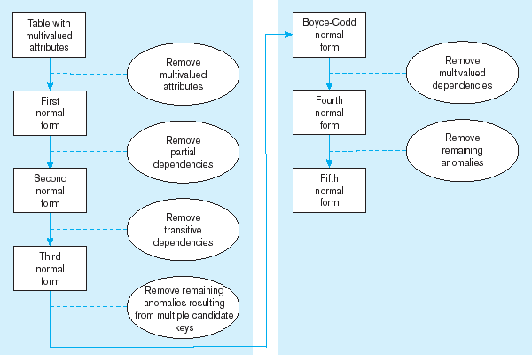
Steps in normalization
16

Slide 17

















FIRST NORMAL FORM
No multivalued attributes
Every attribute value is atomic
Fig. is not in 1st Normal Form (multivalued attributes) ➔ it is not a relation
All relations are in 1st Normal Form
17

Slide 18
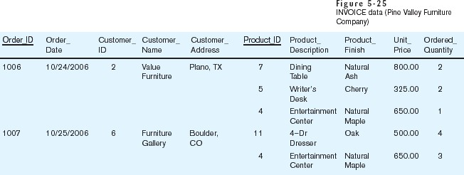
Table with multivalued attributes, not in 1st normal form
Note: this is NOT a relation
18

Slide 19
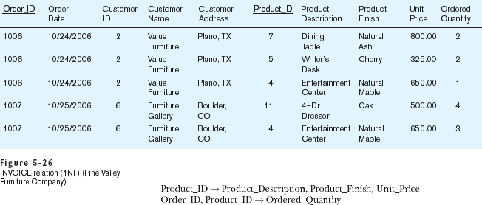
Table with no multivalued attributes and unique rows, in 1st
normal form
Note: this is relation, but not a well-structured one
19

Slide 20











ANOMALIES IN THIS TABLE
Insertion–if new product is ordered for order 1007 of existing customer,
customer data must be re-entered, causing duplication
Deletion–if we delete the Dining Table from Order 1006, we lose information concerning this item's finish and price
Update–changing the price of product ID 4 requires update in several records
Why do these anomalies exist?
Because there are multiple themes (entity types) in one relation. This results in duplication and an unnecessary dependency between the entities

Slide 21












SECOND NORMAL FORM
1NF PLUS every non-key attribute is fully functionally dependent on the ENTIRE primary key
  Every non-key attribute must be defined by the entire key, not by only
part of the key
  No partial functional dependencies

Slide 22
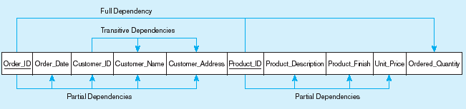

Functional dependency diagram for INVOICE
Order_ID ➔ Order_Date, Customer_ID, Customer_Name, Customer_Address Customer_ID ➔ Customer_Name, Customer_Address
Product_ID ➔ Product_Description, Product_Finish, Unit_Price Order_ID, Product_ID ➔ Order_Quantity
Therefore, NOT in 2nd Normal Form

Slide 23
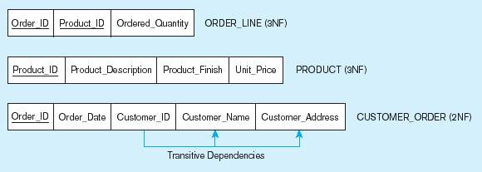




Removing partial dependencies
Getting it into Second Normal Form
Partial dependencies are removed, but there are still transitive dependencies
23

Slide 24













THIRD NORMAL FORM
2NF PLUS no transitive dependencies (functional dependencies on non-primary-key attributes)
Note:This is called transitive, because the primary key is a determinant for another attribute, which in turn is a determinant for a third
Solution: Non-key determinant with transitive dependencies go into a new table; non-key determinant becomes primary key in the new table and stays as foreign key in the old table
24

Slide 25
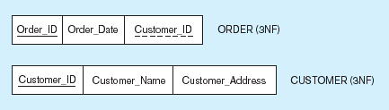




Removing partial dependencies
Getting it into Third Normal Form
Transitive dependencies are removed
25

Slide 26
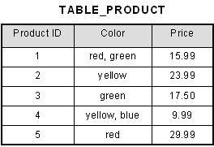
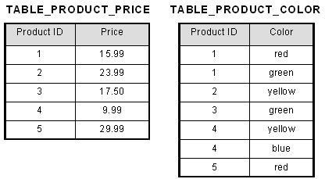
EXAMPLE OF NORMALIZATION
Un-Normalized Table
Table in 1st Normal Form
26
6/10/2020

Slide 27
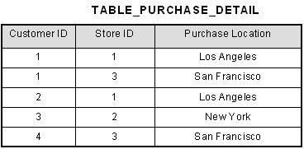
2ND FORM OF NORMALIZATION
This table has a composite primary key [Customer ID, Store ID]. The non-key attribute is [Purchase Location].
In this case, [Purchase Location] only depends on [Store ID], which is only part of the
primary key.Therefore, this table does not satisfy second normal form.
To bring this table to second normal form, we break the table into two tables.
27
6/10/2020

Slide 28
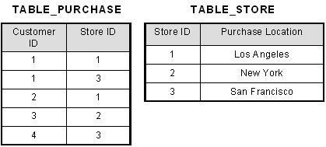
2ND FORM OF NORMALIZATION
What we have done is to remove the partial functional dependency that we initially had. Now, in the table [TABLE_STORE], the column [Purchase Location] is fully dependent on the primary key of that table, which is [Store ID].
28
6/10/2020

Slide 29
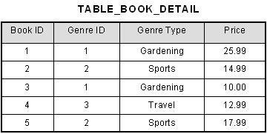
3RD FORM OF NORMALIZATION
In the table [Book ID] determines [Genre ID], and [Genre ID] determines [Genre Type]. Therefore, [Book ID] determines [Genre Type] via [Genre ID] and we have transitive functional dependency, and this structure does not satisfy third normal form.
To bring this table to third normal form, we split the table into two tables.
29
6/10/2020

Slide 30
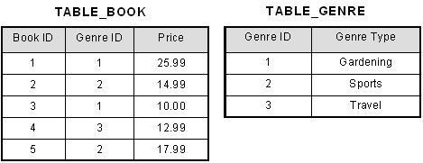
3rd FORM OF NORMALIZATION
Now all non-key attributes are fully functional dependent
only on [TABLE_BOOK], both [Genre ID] and [Price] are only dependent
the primary on [Book
key. In
ID]. In
30
[TABLE_GENRE], [Genre Type] is only dependent on [Genre ID].
6/10/2020

